Slide 1
Introduction to Data Management
CS201 – Manajemen Data Magister Ilmu Komputer Universitas Budi Luhur

Slide 2

Motivation
The world is
drowning
in data

Slide 3

In one second…
8,657 Tweets sent
941 Instagram photos uploaded
1,587 Tumblr posts
4,090 Skype calls
79,012 GB of Internet traffic
77,298 Google searches
80,575 YouTube videos viewed
2,837,686 Emails sent (67% spam)
Sumber: https://www.internetlivestats.com

Slide 4
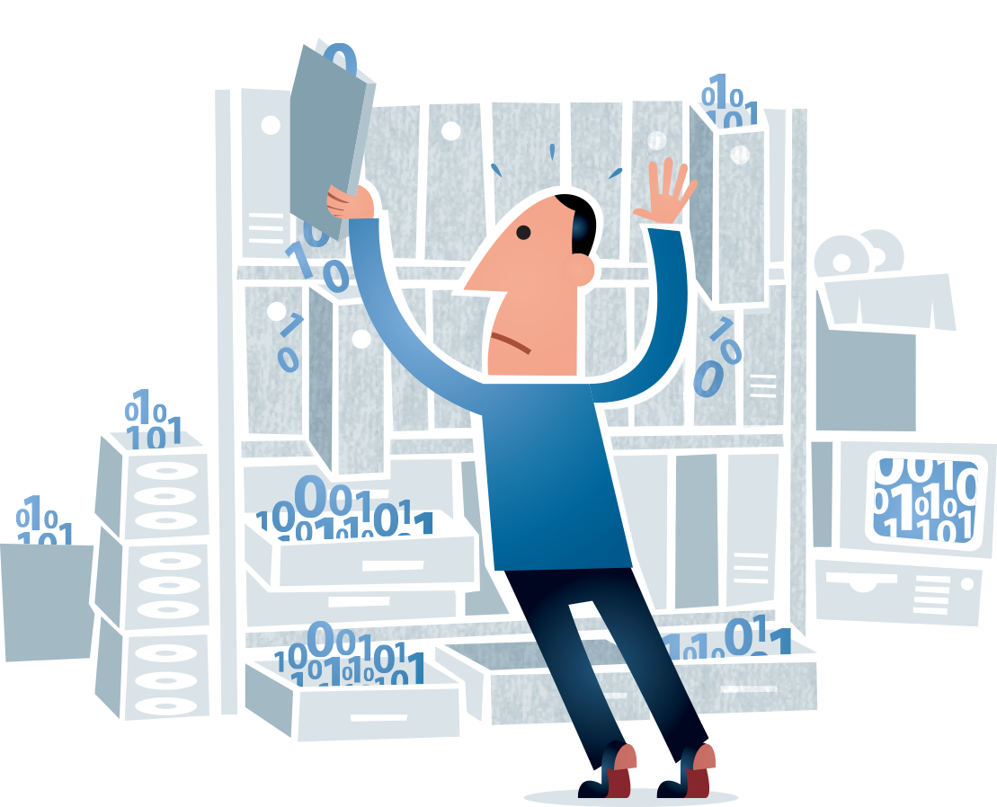
Motivation
Need professional to help manage it
Help domain scientist achieve new discoveries
Help companies provide better services
Help governments become more efficient

Slide 5
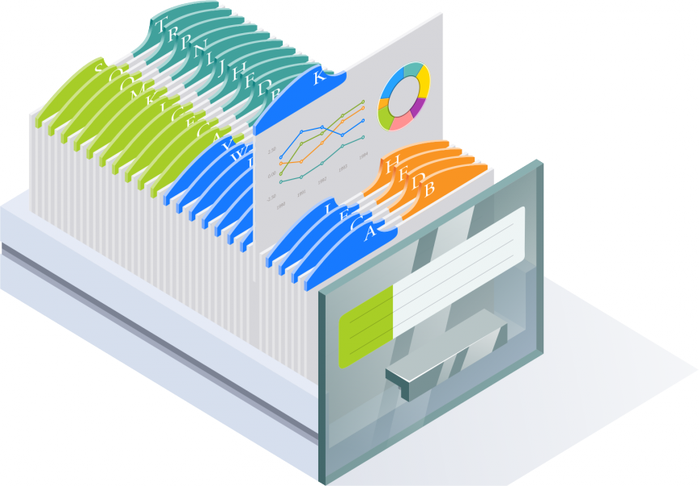
Data Management is Universal
Managing data is at the core of most apps / services
Small or large
Modern or older ones
Doing it right typically makes the everything else easier.

Slide 6
Course Outline
Introduction to Data Management
Data Models
Conceptual DB Modelling
Schema / Physical DB Modelling
Normalization
SQL Basics
Advanced SQL
Transaction Management
DB Administration and Security
Query Optimization
Datawarehouse dan OLAP
Data mining
Big Data
NoSQL

Slide 7
References
Hector Garcia-Molina, Jeffrey D. Ullman & Jennifer Widom (2009), “Database Systems: The Complete Book, 2nd Edition”, Pearson Education Publishing
Thomas M Connolly & Carolyn Begg (2015), “Database Systems: A Practical Approach to Design, Implementation, and Management 6th Edition”, Pearson Education Publishing.
Achmad Solichin (2010), “MySQL5: Dari Pemula Hingga Mahir”, Achmatim.Net. http://bit.ly/BukuGratisMySQL5

Slide 8

Grading
Assignment : 30%
Mid test : 30%
Final test : 40%

Slide 9
Introduction to Database

Slide 10
Database
What is a database?
Is an Excel/CSV file a database?
A collection of files storing related data.
A structured set of data held in a computer, especially one that is accessible in various ways (Google)
a collection of information that is organized so that it can be easily accessed, managed and updated (SQLServer)
an organized collection of data (Wikipedia)
Example of database
Student database
Employee database
Store database

Slide 11
Database Management System (DBMS)
What is DBMS?
software that handles the storage, retrieval, and updating of data in a computer system (Google)
a type of software that allows you to define, manipulate, retrieve and manage data stored within a database (SQL Server)
a computer-software application that interacts with end-users, other applications, and the database itself to capture and analyze data. (Wikipedia)
Example of DBMS: MySQL, Oracle, SQL Server, PostgreSQL, etc

Slide 12
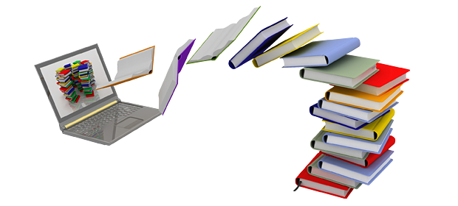
An Example: Online Bookstore
What data do we need?
What capabilities on the data do we need?
Who can access the data?

Slide 13
Required Functionality for Data Management
Describe real-world entities in terms of stored data.
Persistently store large datasets
Efficiently query & update
Easily change structure (add attributes, relations, etc)
Enable simultaneous updates
Crash recovery
Security and integrity

Slide 14
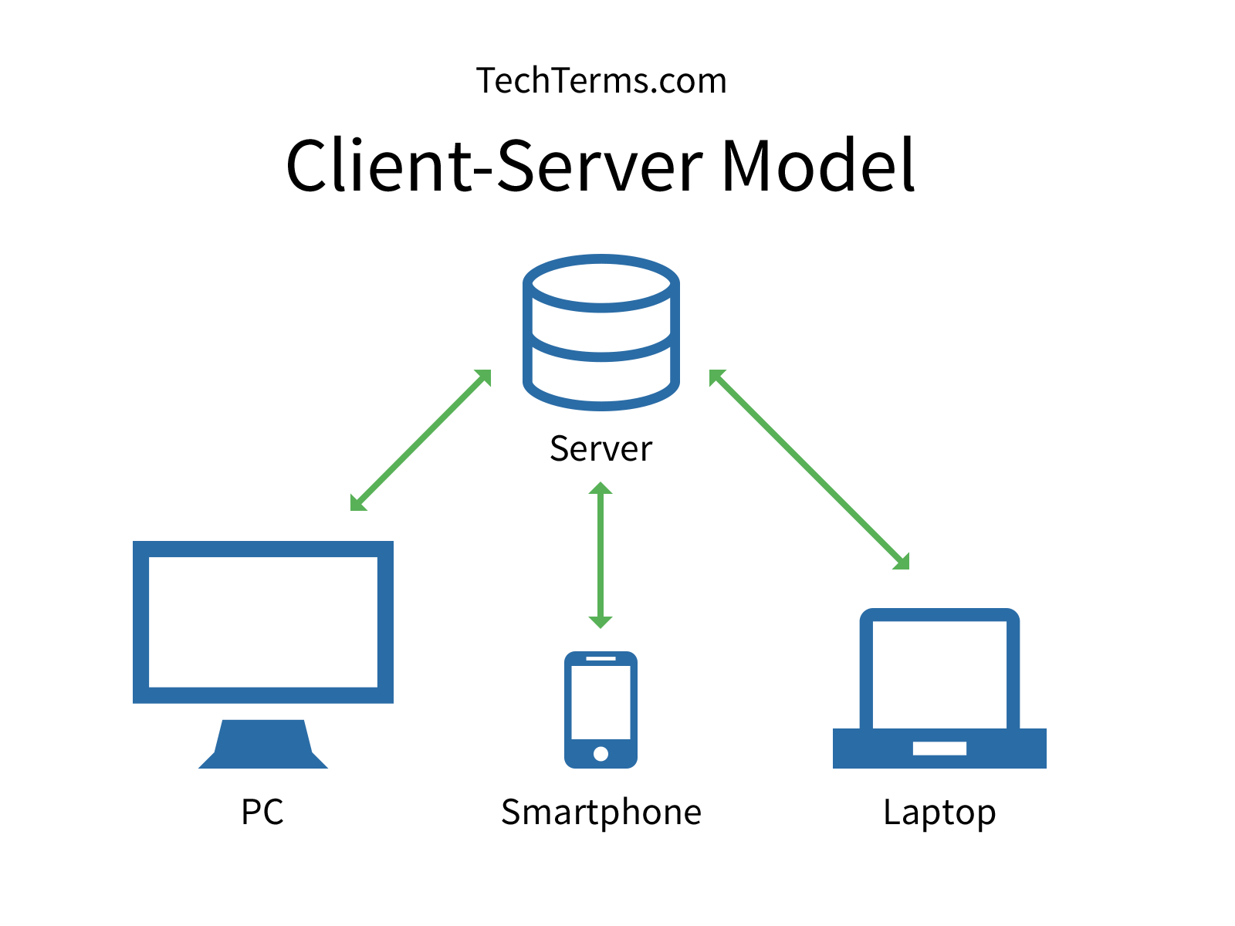
Client-Server Architecture
One server that stores the database (DBMS)
Many clients run apps and connect to the DBMS
Client “talk” to server using a protocol

Slide 15
Key People
DB application developer : write programs that query and modify data
DB designer: establishes schemas
DB administrator: loads data, tune systems, keep whole things running
Data analyst: data mining, data integration
DBMS implementer: build the DBMS

Slide 16
Key concepts
Data models
Relational, XML, JSON, Object
Schema vs data
Query language
DDL, DML, DCL, Joins & Aggregation.
Data independence
Can change physical or logical schema without affecting apps
Query optimizer
Transaction

Slide 17
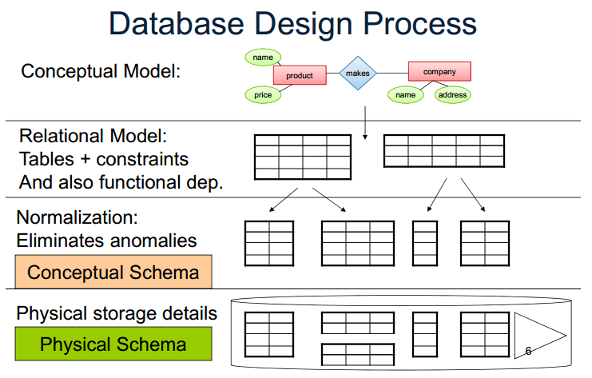
Next…

Slide 18
Questions?

Slide 19
Slide ini disusun oleh:
Achmad Solichin
Universitas Budi Luhur
achmatim@gmail.com | achmad.solichin@budiluhur.ac.id
Web http://achmatim.net
Twitter @achmatim

